Slide 1
Objectives
In this session, you will learn to:
  Create image gallery

Slide 2
Creating Image Gallery
jQuery plug-ins:
  Are used to create image gallery.
  Are prewritten and easy to use programs, which enhance the jQuery code.
While using jQuery plug-ins, an image gallery can be created by:
  Using colorbox plug-in
  Using galleria plug-in

Slide 3
Using Colorbox Plug-in
The colorbox plug-in:
  Is a light-weight jQuery plug-in that enables displaying a collection of images one-by-one using the previous and next buttons.
  Can be used to display an image with a variety of transition effects, such as fade or elastic, in the middle of an elegant frame known as lightbox.
  The lightbox is created at the center of the Web page over a translucent film surrounding the lightbox.

Slide 4
Using Colorbox Plug-in (Contd.)
The colorbox folder comprises the following folders:
  colorbox:
    This folder comprises the jquery.colorbox.js file, which is the colorbox plug-in file.
  example1, example2, example3, example4, and example5:
    These folders contain the sample implementation of the colorbox plug-in.
    Each of these folders contains the following sub-folders and files:
      colorbox.css
      images folder
      index.html

Slide 5
Using Colorbox Plug-in (Contd.)
You can customize the display of images in an image gallery or a slideshow by using the colorbox plug-in.
For this purpose, the colorbox plugin provides several keys.
These keys need to be passed as parameters to the colorbox() method.

Slide 6
Using Colorbox Plug-in (Contd.)
  The following table lists some of the keys that can be used with the colorbox() method.
Key | Description
Transition | It specifies the type of transition such as fade, elastic or none of an image displayed on the Web page. Its default value is elastic.
Speed | It specifies the speed of transition with which an image is displayed. Its default value is 350 milliseconds.
Width | It specifies the total width of the frame in which an image is displayed. Its default value is false which means that the width of the frame is not fixed and varies according to width of the image.
Height | It specifies the total height of the frame in which an image is displayed. Its default value is false, which means that the height of the frame is not fixed and varies according to the height of the image.
innerWidth | It specifies the inner width of the frame in which an image is displayed without including border and buttons.
innerHeight | It specifies the inner height of the frame in which an image is displayed without including border and buttons. Its default value is false.

Slide 7
Using Colorbox Plug-in (Contd.)
For example:
  <!DOCTYPE html>
  <html>
  <head>
  <link media="screen" rel="stylesheet" href="CSS/colorbox.css" />
  <script src="jQueryS/jquery-1.6.2.min.js"></script>
  <script src="jQueryS/jquery.colorbox.js"></script>
  <script type="text/javascript">
  $(document).ready(function(){
  $("a").colorbox({transition:"fade", height:"600", width:"650"});
  });
  </script>
  </head>

Slide 8
Using Colorbox Plug-in (Contd.)
  <body>
  <h1>Product Demonstration</h1>
  <a href="contentFiles/Product1.jpg">Product1 photo</a>
  </body>
  </html>

Slide 9
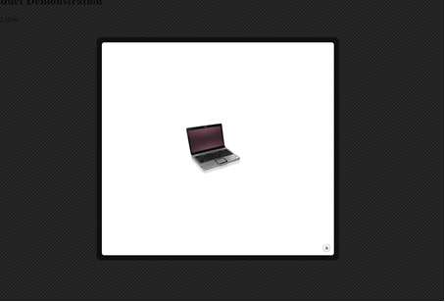
Using Colorbox Plug-in (Contd.)
The output of the preceding code after the Product1 photo link is clicked will be displayed as shown in the following figure.

Slide 10
Using Colorbox Plug-in (Contd.)
To display a set of images or group of images using a lightbox, you need to add a link to each image using the <a> tag and also specify the same value for the rel attribute of each <a> tag defined for the images.
The rel attribute indicates the relationship between the current document and the path specified by the href attribute.
By providing the same value for the rel attribute for all the images, we can relate them to a single group.

Slide 11
Using Colorbox Plug-in (Contd.)
For example:
  <!DOCTYPE html>
  <html>
  <head>
  <link media="screen" rel="stylesheet" href="css/colorbox.css" />
  <script src=" jQueryS/jquery-1.6.2.min.js"></script>
  <script src=" jQueryS/jquery.colorbox.js"></script>
  <script>
  $(document).ready(function(){
  $("a").colorbox({slideshow:true,current:false});
  });
  </script>
  </head>

Slide 12
Using Colorbox Plug-in (Contd.)
  <body>
  <h1>Product Demonstration</h1>
  <a href=" contentFiles/Product1.jpg" rel="collection">Click here to view slideshow
  </a>
  <a href=" contentFiles/Product2.jpg" rel="collection"></a>
  <a href=" contentFiles/Product3.jpg" rel="collection"></a>
  </body>
  </html>

Slide 13
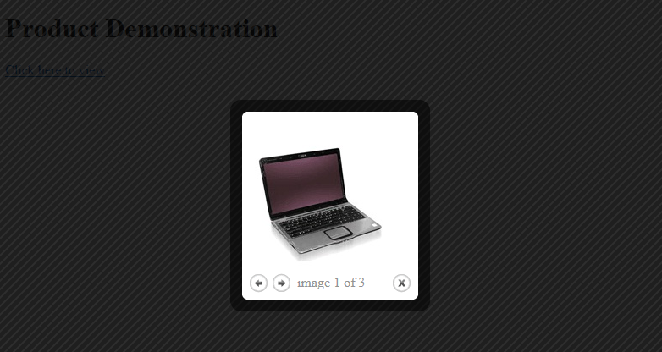
Using Colorbox Plug-in (Contd.)
The following figure displays the output with the previous and next buttons.

Slide 14
Using galleria Plug-in
The galleria plug-in is a jQuery plug-in used for creating elegant and professional looking image galleries.
This plug-in is used to display an image gallery and create thumbnails of the images to be displayed in the gallery automatically.
When the mouse pointer is clicked over a thumbnail size image, a larger version of the image is displayed using a transition effect on the same Web page.

Slide 15
Using galleria Plug-in (Contd.)
To create an image gallery using the galleria plug-in, you need to download the galleria.zip file from the Internet.
Then, extract the galleria folder from the galleria.zip file at a desired location on your system.
The galleria folder comprises the galleria-1.2.5.min.js file, which is the galleria plug-in to be used to implement the functionality of creating the image gallery.

Slide 16
Demo: Creating an Image Gallery
Problem Statement:
  BookYourShow.com is a popular website, which allows booking movie tickets online. To enhance the browsing experience of the users, the management of BookYourShow.com website wants that the website should display the thumbnail images of the movies. When a customer clicks an image, the larger size of the image should be displayed on the same Web page without navigating to another Web page. Therefore, they approach a Web developer to implement the required functionality on the website. After analyzing the requirement, the Web developer decides to create an image gallery by using the galleria plug-in. Help the Web developer to create the image gallery.

Slide 17
Demo: Creating an Image Gallery (Contd.)
Solution:
  To perform this activity, you need to perform the following tasks:
    Use the galleria plug-in and jquery-1.6.2.min.js file.
    Add image files.
    Set the theme.
    Apply the galleria plug-in.
    View the imageGallery page and verify the output.

Slide 18
Summary
In this session, you learned that:
  jQuery plug-ins are prewritten and easy to use programs, which enhances the jQuery code.
  Using jQuery plug-ins, you can create the image gallery by displaying the images dynamically at run time on the same Web page.
  The Colorbox plug-in enables displaying larger size images on the same Web page when a user clicks a hyperlink or an image.
  When the image is displayed in larger size, lightbox fills the background of the image with the translucent film.
  The image gallery can be created using the galleria plug-in.
  The galleria plug-in automatically creates the thumbnail size of images in an image gallery.

